Slide 1

Overcoming Scale Usage
Heterogeneity
Sahil - Aditya - Meha - Archit

Slide 2
Contents
Introduction: What is Scale Usage Heterogeneity?
Model Details: How do we combat SUH?
Dataset and Implementation: How do our analytics change once we account for SUH?

Slide 3
Contents
Introduction: What is Scale Usage Heterogeneity?
Model Details: How do we combat SUH?
Dataset and Implementation: How do our analytics change once we account for SUH?

Slide 4



What is Scale Usage Heterogeneity ?
Grumpy Sam
Happy john
QUESTIONS
Overall satisfaction
Quality of food
Value for money
Notes:
Customer satisfaction surveys, and survey research in general, often collect data on discrete rating scales. Survey research practitioners have found that respondents vary in their usage of the scale, common patterns include using only the middle of the scale or using the upper or lower end In addition, it has been observed that there are large cultural or cross-country differences in scale usage, making it difficult to combine data across cultural or international boundaries
These different usage patterns, which we term ‘scale usage heterogeneity’, It can impart biases to many of the standard analyses

Slide 5
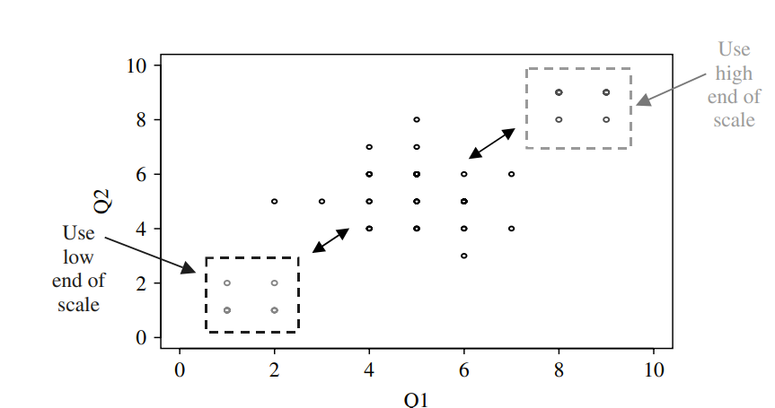
What issues does it cause ?
Any covariance-based methods such as linear regression will be heavily biased!
Scale Usage Heterogeneity causes
spurious correlations
We may get biased results for basic questions like :
Relationship between overall satisfaction and specific attributes
Identification of customers with extreme views
Notes:
If all the customers have same scale usage, then the distribution will be somewhat centered
In the typical customer satisfaction survey, respondents are asked to give their overall satisfaction with a product as well as assessments of satisfactions with various dimensions of the product or service. Ratings are made on five-, sevenor ten-point scales. We will focus on two major uses of customer satisfaction ratings data: measurement of the relationship between overall satisfaction and satisfaction with specific product attributes; and identification of customers with extreme views. Scale usage heterogeneity can substantially bias analyses aimed at either use.
The middle group of points in Figure CS3.2 represents a hypothetical situation in which all respondents have the same scale usage. If some respondents use the upper or lower end of the scale, this will move points outward from the middle grouping, creating a higher but spurious correlation. Thus, any covariance-based analysis of rating scale data such as regression or factor analysis can be substantially biased by scale usage heterogeneity
. In addition, any cluster analysis or filtering of the data for respondents with extreme views will tend to identify a group of nay or yea sayers whose true preferences may not be extreme or even similar. Now Aditya will walk us though what are one of the common approaches used by Practicitioners to handle this and what are its drawbacks.

Slide 6
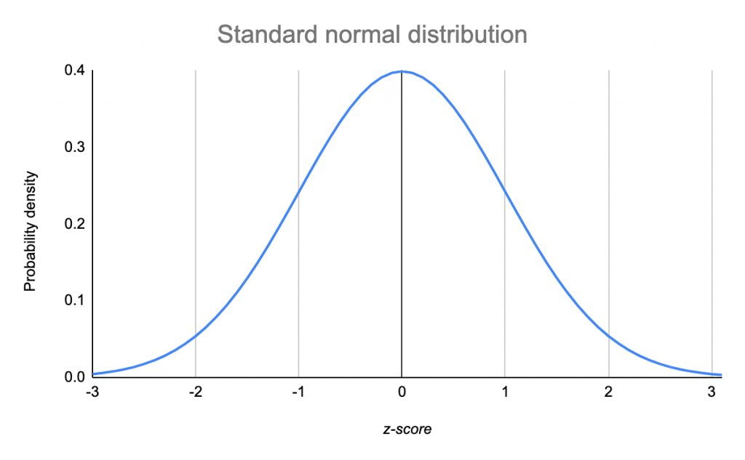
Typical Solution & Drawbacks
 | Q1 | Q2 | Q3 | Q4 | Q5
Grumpy Sam | 2 | 3 | 4 | 2 | 1
Happy John | 8 | 9 | 8 | 10 | 10
What are the issues with this approach?
Assumption that Response Data is Continuously Distributed
Mean and standard deviation calculated over a small number of questions are often imprecise
Grumpy Sam
Happy John
Notes:
The standard procedure for coping with scale usage heterogeneity is to center each respondent’s data by subtracting the mean over all questions asked of the respondent and dividing by the standard deviation. The standard procedure for coping with scale usage heterogeneity is to center each respondent’s data by subtracting the mean over all questions asked of the respondent and dividing by the standard deviation

Slide 7
Contents
Introduction: What is Scale Usage Heterogeneity?
Model Details: How do we combat SUH?
Dataset and Implementation: How do our analytics change once we account for SUH?

Slide 8
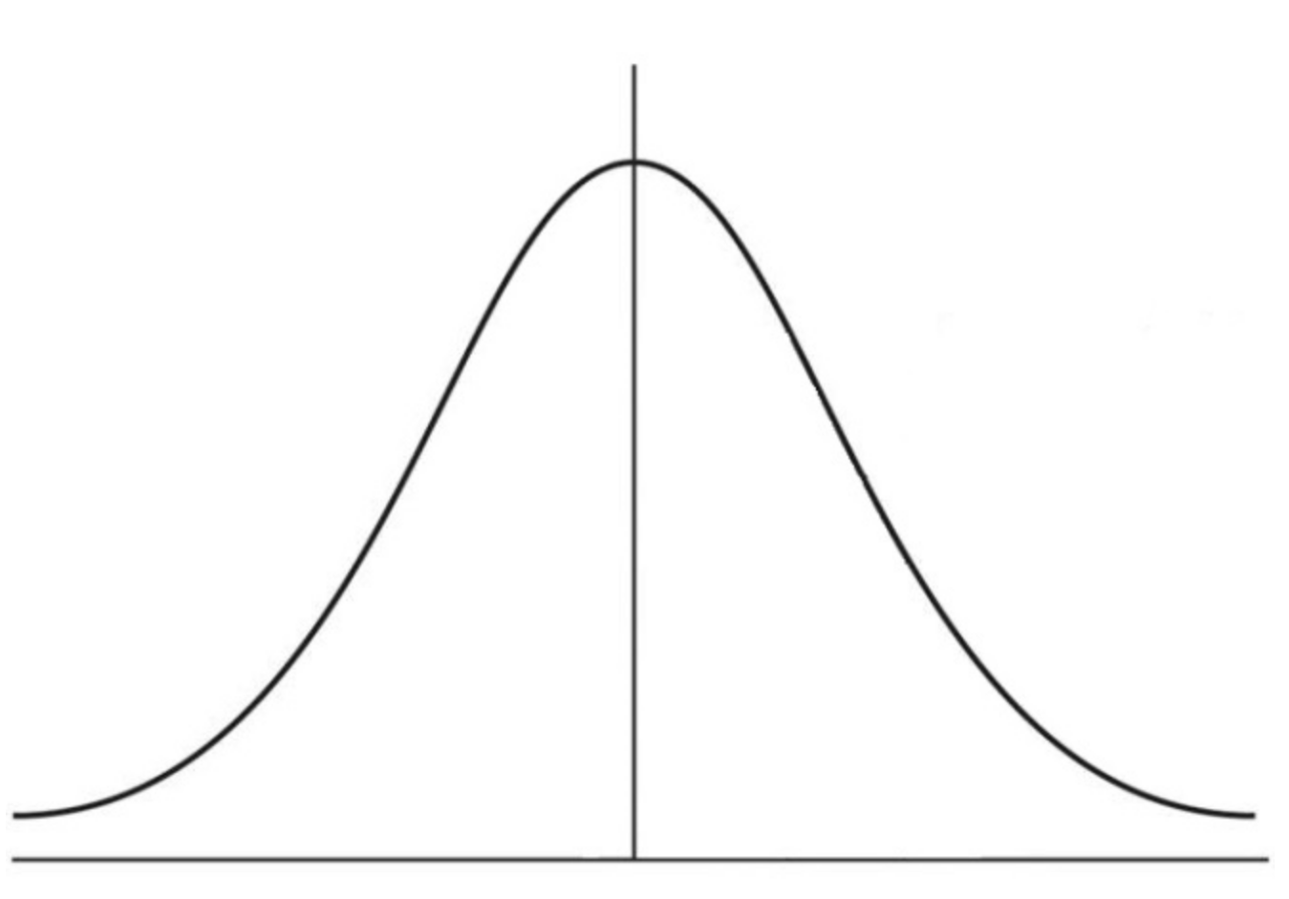
Model driven way to track heterogeneity
Underlying continuous distribution – Example for a question with 10-point response scale
1
2
3
4
5
6
7
8
9
10
8
+
8
-
C₅
C₆
C₁
C₂
C₃
C₄
C₇
C₈
C₉

Slide 9
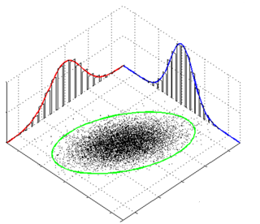
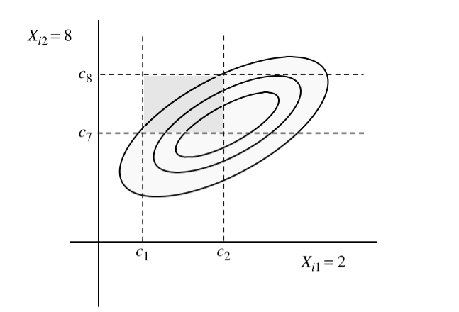
Model driven way to track heterogeniety
We used Bayesian model to remove the heterogeneity
Probability (x = [2,8]) = Integral of the joint normal distribution over the appropriately defined region.
Discrete Ratings
Q1 | Q2
2 | 8

Slide 10
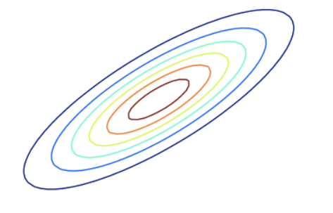

Model driven way to track heterogeneity
We used Bayesian model to remove the heterogeneity
Question- 2
Probability (x = [2,8]) = Integral of the joint normal distribution over the appropriately defined region.
Question- 1
Final Model

Slide 11
Contents
Introduction: What is Scale Usage Heterogeneity?
Model Details: How do we combat SUH?
Dataset and Implementation: How do our analytics change once we account for SUH?

Slide 12

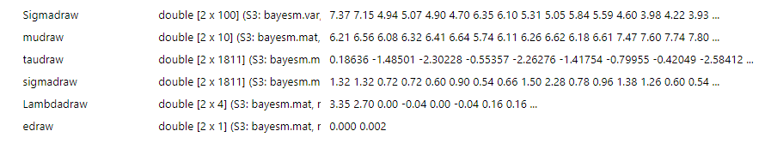
Model Implementation
Package Used : bayesm()
Function Used : RScaleUsage()
5000 MCMC Iterations
Output:

Slide 13
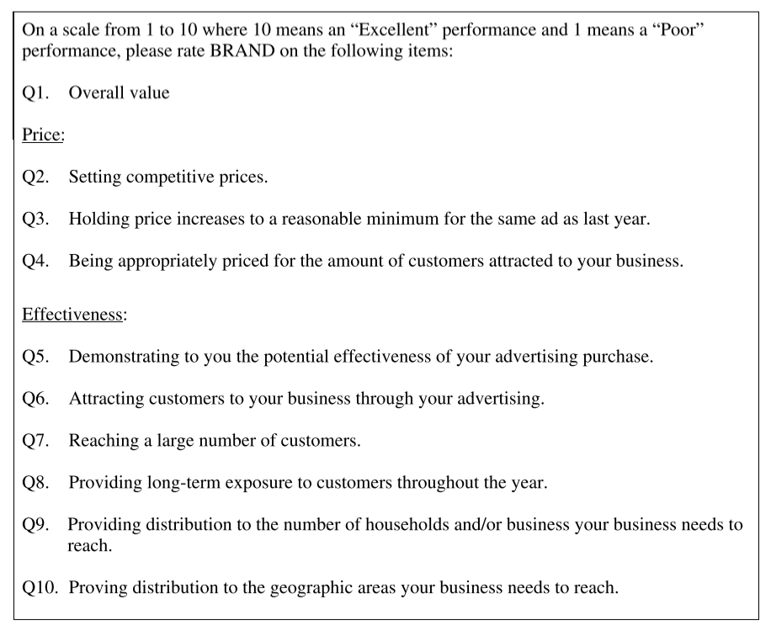


Data Overview
Survey Overview
Dataset Overview
Rater | q1 | q2 | q3 | q4 | q5 | q6 | q7 | q8 | q9 | q10
1 | 2 | 8 | 8 | 2 | 2 | 2 | 2 | 6 | 8 | 6
2 | 7 | 8 | 8 | 8 | 7 | 6 | 8 | 9 | 8 | 10
3 | 5 | 3 | 3 | 2 | 3 | 5 | 4 | 4 | 7 | 7
4 | 8 | 7 | 6 | 7 | 8 | 8 | 8 | 8 | 8 | 8
5 | 2 | 1 | 1 | 1 | 1 | 1 | 10 | 2 | 10 | 8
1
10
Rating Scale
0
Questions: 10
Respondents: 1,811

Slide 14
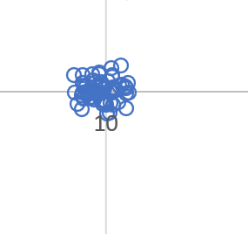
Respondent Rating Pattern: Raw Data
People using Top end of scale
64

Slide 15
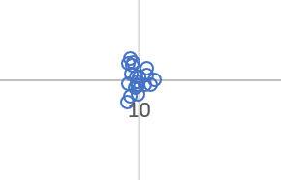
Respondent Rating Pattern: Adjusted Data
People using Top end of scale
20

Slide 16

Correlation : Standard Approach

Slide 17
Correlation Between Questions
RAW DATA
Correlations are consistently higher
Q2
Q2: Setting competitive Prices
Adjusted Data
Correlations are consistently lower
Q9
Q9: Providing distribution to the number of households and/or business your business needs to reach.

Slide 18
Future Explorations
How questionnaires and surveys can be designed to minimize scale usage heterogeneity
Does SUH impact different industries differently
Assess the SUH on different types of scales

Slide 19
APPENDIX

Slide 20
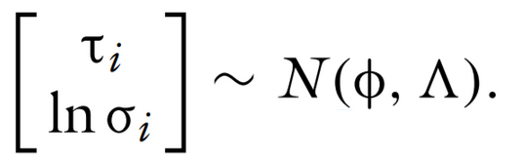
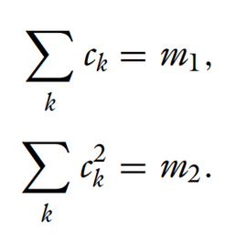
Methodology
Location and scale may or may not be independent. So we assume:
This allows for correlation. In most applications of hierarchical models, the location and scale parameters are assumed to be independent
For further flexibility, we also allow cutoffs to be non-linear, non-uniform with the following restrictions:
Non-uniform Cutoffs

Slide 21
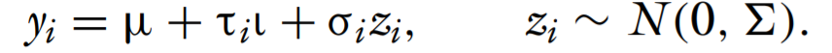



Methodology
Convert each user's discrete rating, y, as an expression of their location and scale, as follows:
This allows us to capture users like Alice who has a non-zero starting location
Also allows us to capture Bob, who has a very small rating scale

Slide 22
Attribute Analysis
Relationship between overall satisfaction and specific attributes – Comparison Before & After
Variables | Coefficients – Raw Data | Coefficients – Adjusted Data | P-value (Significance)
Q2 | 0.112 | 0.121 | 0.00%
Q3 | 0.048 | 0.009 | 66.72%
Q4 | 0.314 | 0.323 | 0.00%
Q5 | 0.040 | 0.042 | 3.03%
Q6 | 0.330 | 0.354 | 0.00%
Q7 | 0.112 | 0.107 | 0.00%
Q8 | 0.034 | -0.016 | 44.44%
Q9 | -0.041 | -0.020 | 42.41%
Q10 | 0.040 | 0.035 | 14.30%

Slide 23

Respondent Rating Pattern: Adjusted Data
Would the outliers change if the scale heterogeneity was removed?
Would the nature of correlations between questions change?
Would the correlation between the overall score and individual questions change?

